Slide 1
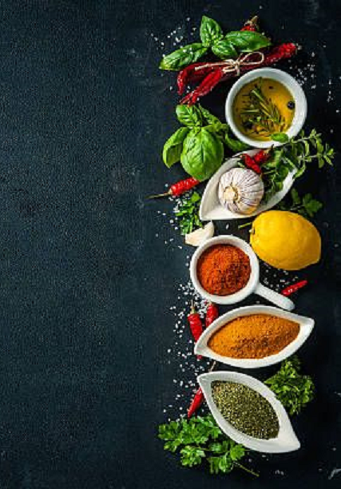
RECIPE RECOMMENDATION SYSTEM

Slide 2
SRS DOCUMENTATION
SRS DOCUMENT

Slide 3
Mission of RRS
The Mission/Motive of this Recipe Recommendation System is to recommend most favorited and reviewed recipes to the end-users .

Slide 4
PROBLEM STATEMENT
Our Mini-Project will be a Recipe Recommendation System.
The purpose of this system is to recommend recipes that can be prepared with available ingredients and recommend the recipes that are most preferred by the users.

Slide 5
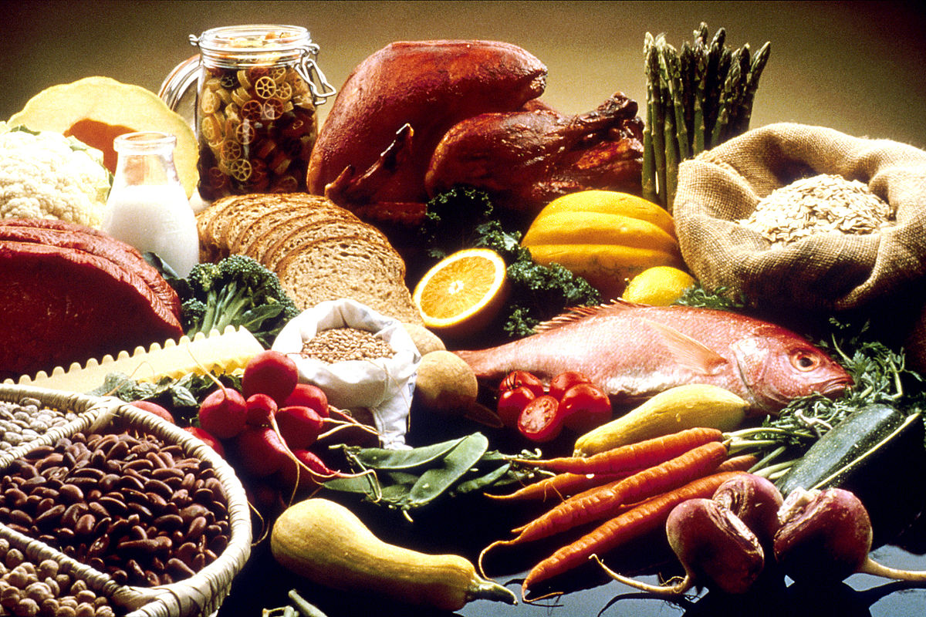
DOMAIN OF RRS
The Domain of our Recipe Recommendation System will be
MOBILE Application Development.
Currently the Project is available as a desktop application.

Slide 6
Product Features
USER ACCOUNT MANAGEMENT:
The User of this product will be provided with a account which can be logged in using mobile number.
INGREDIENTS RECOGNITION USING IMAGE PROCESSING-OBJECT DETECTION:
The product uses CV for object detection (ingredient detection) and adds up the detected ingredients in to the Inventory list.

Slide 7
Product Features(Cont..)
INVENTORY (INGREDIENTS LIST) MANAGEMENT:
The available list of ingredients can be managed here.
RECIPE RECOMMENDATION:
Finally , the available list of ingredients will be sent to the server to retrieve information about ingredients which can be prepared with the available ingredients.
If more recipes can be prepared with same ingredients , then the system recommends the most rated recipe along with the procedure to prepare the recipe.

Slide 8
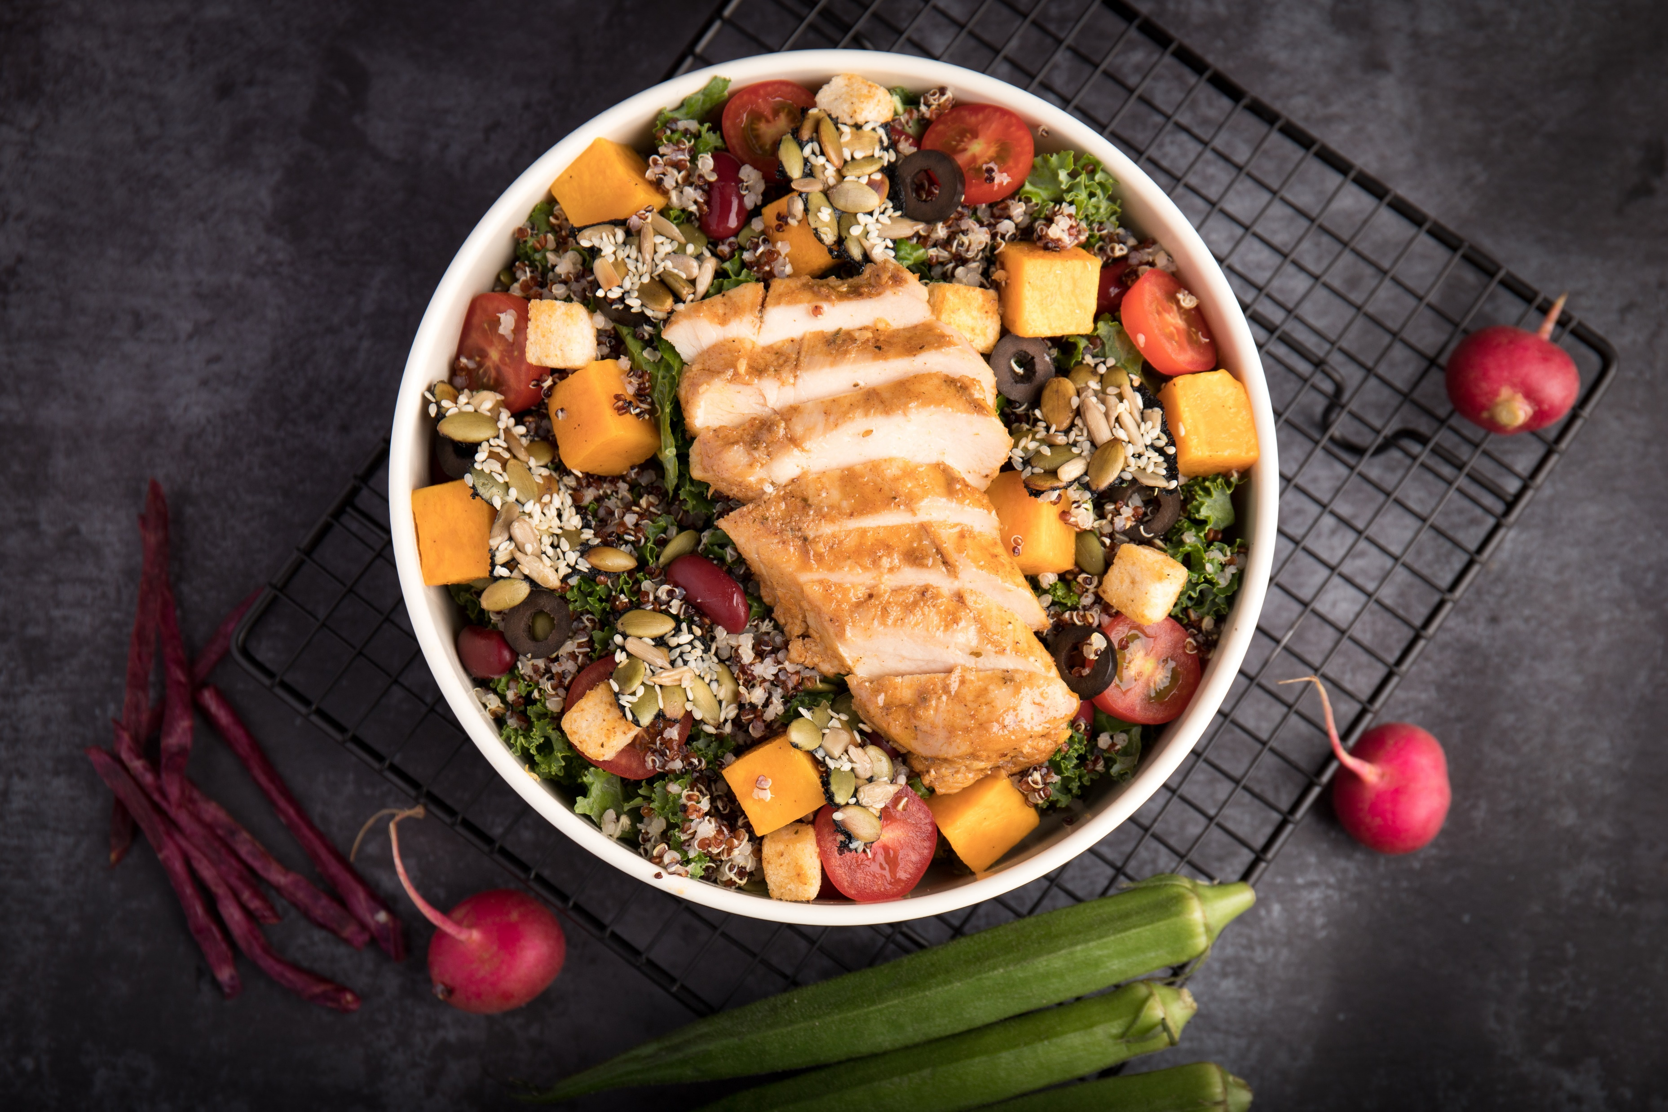
Objective
The objective of the Recipe Recommendation System is to help customers/users to help in determining the recipe that is feasible to prepare with the available ingredients.

Slide 9
Module Explanation
We have used the following modules in our Project.
Tkinter - Module for GUI for application.
Pillow(PIL) - Python Imaging Library for image handling and processing.
Threading - Threading processes at same instance.
OpenCV - for Image processing and object recognition.
Google-API-Client – for Image recognition using client service .
Selenium - Web Automation

Slide 10
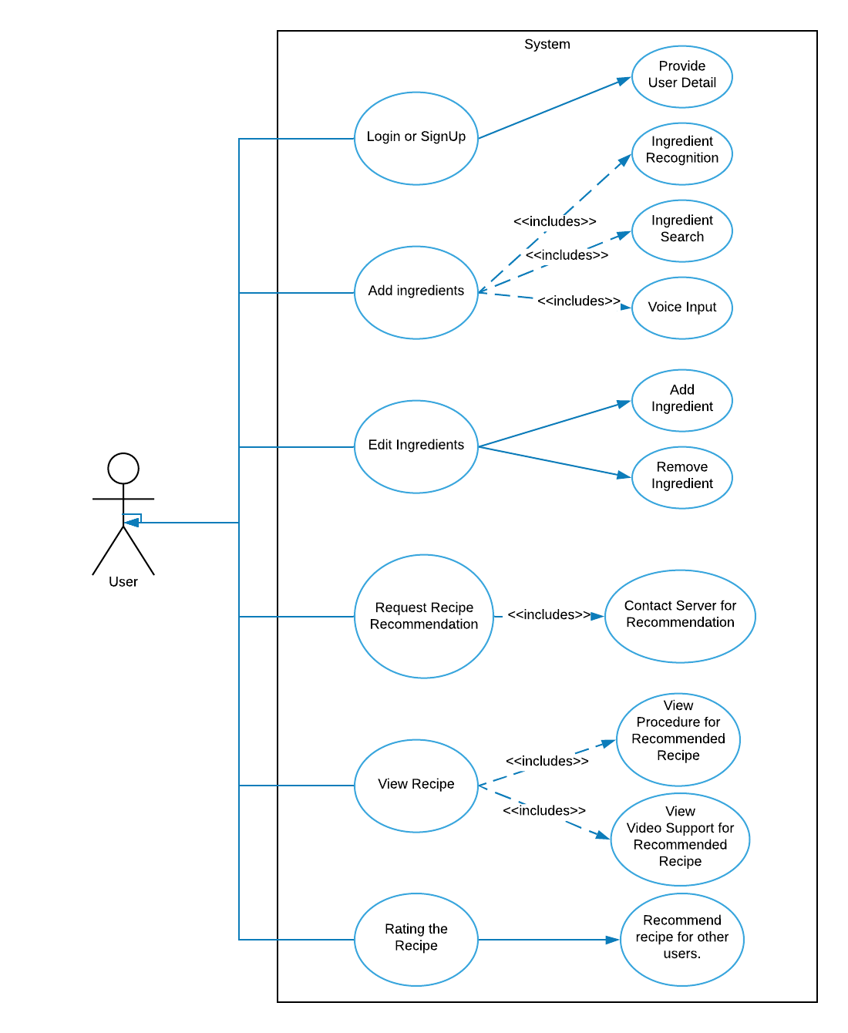
USE CASE DIAGRAM

Slide 11

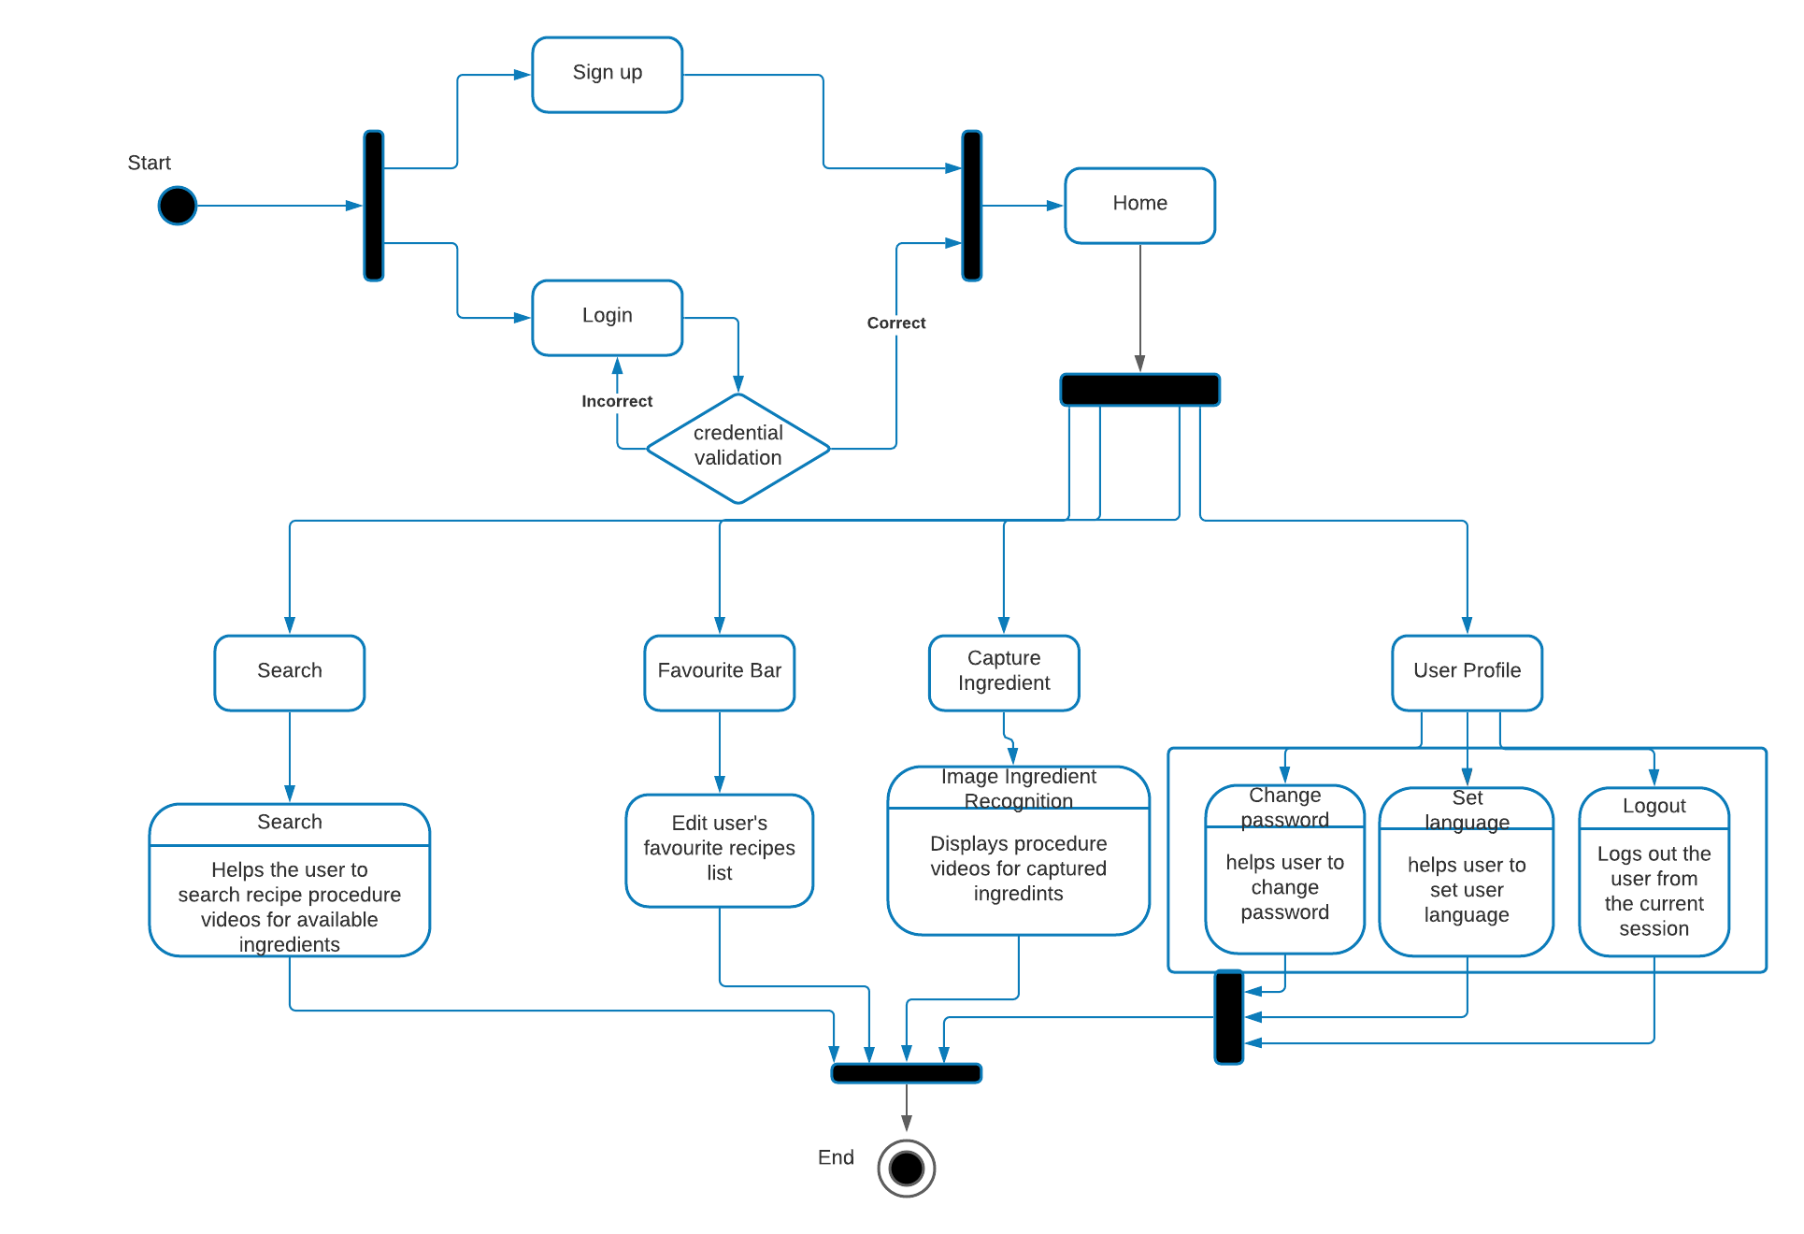

ACTIVITY DIAGRAM

Slide 12
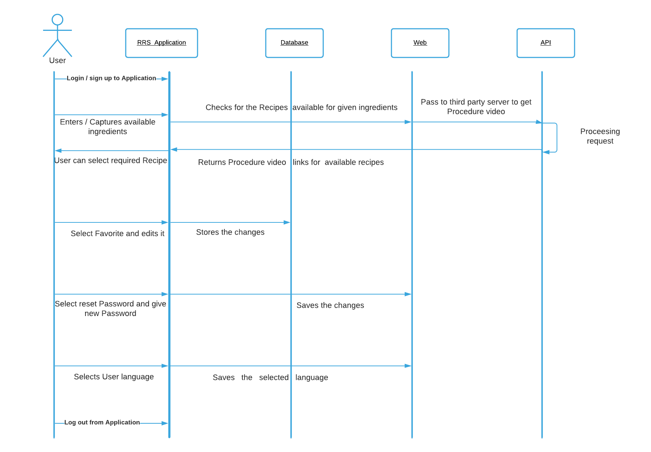
sequence DIAGRAM

Slide 13
SOFTWARE REQUIREMENTS
This application requires minimum specifications like mentioned below
Operating System Windows 8+
Google Chrome / Mozilla Firefox Web Browser
Python3
Social Media Integration (Youtube)

Slide 14
HARDWARE REQUIREMENTS
This Application requires an Integrated camera for object detection
( Ingredient detection ).

Slide 15
Target Customers
The main targeted customers of this Recipe Recommendation are Home Makers .

Slide 16
Project Images

Slide 17
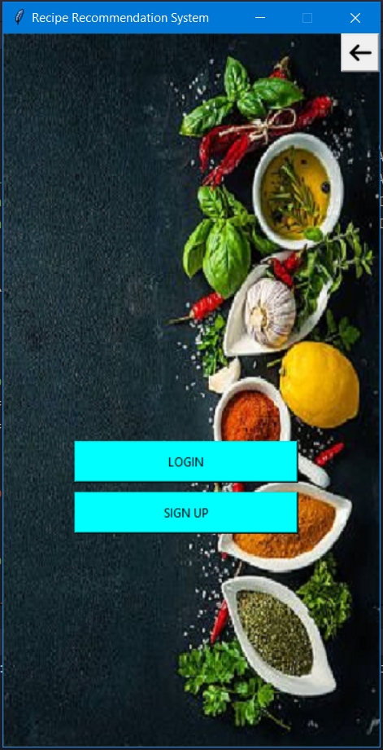
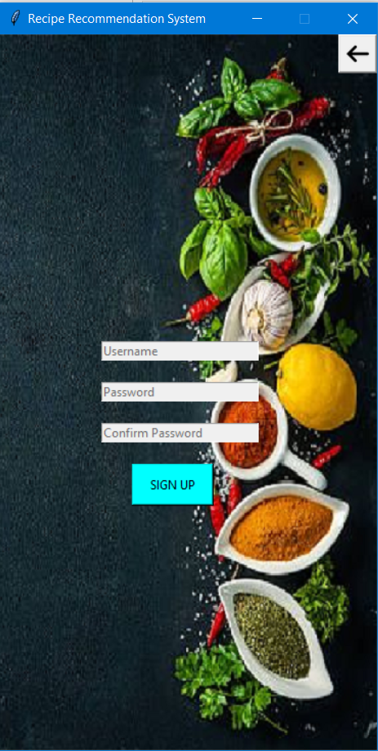

Slide 18
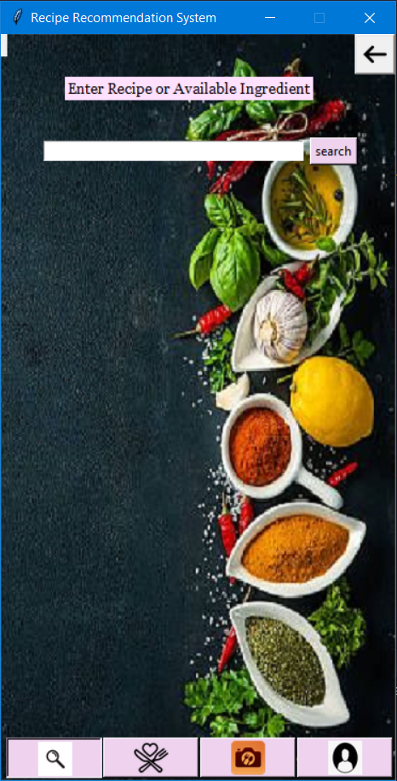
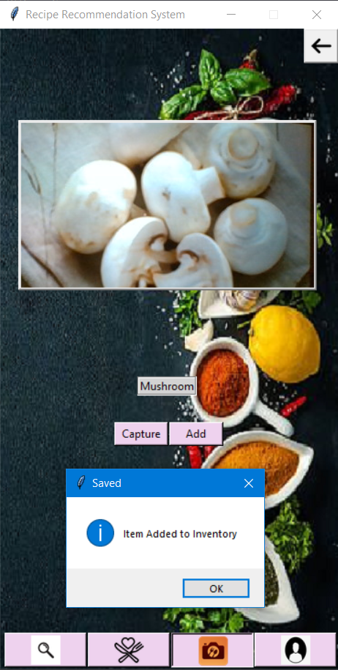

Slide 19
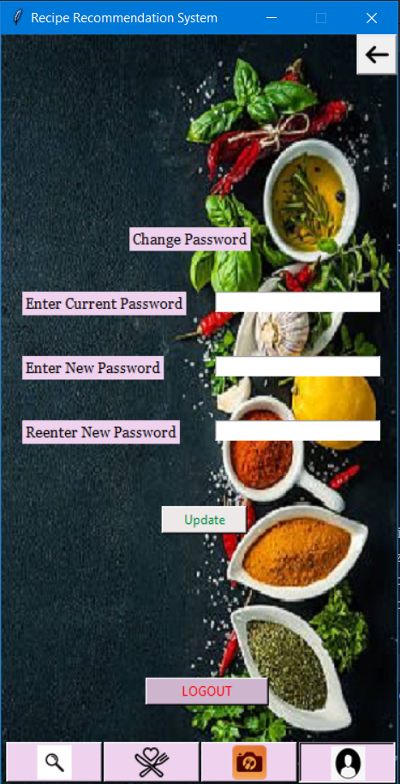

Slide 20
Future Updates
In future the system application will be implemented as a mobile application.

Slide 21
Expected Outcomes
To suggest the best recommended recipe from the available ingredients.
To suggest ingredients based on the review of the customers.
To display the preparation procedure for the Recommended Recipe.
To provide video procedure for the Recommended Recipe.

Slide 22
Project Status
Implementation of the Recommendation Algorithm is underdevelopment.

Slide 23
References
https://krazytech.com/projects/sample-software-requirements-specificationsrs-report-recipe-database

Slide 24
Thank You

